Slide 1
We’ve made 23 of these in the last 4 years

Slide 2
AAPG Foundation $15K grant
Geonews: Timely Geoscience Educational YouTube Videos about Recent Geologic Events by Ning Wang, Zachary Clowdus, Alessandra Sealander and Robert J Stern -Now in press in EGU journal “Geoscience Publications”
3) NSF proposal: Testing the Geonews Strategy to Inclusively Hook, Communicate with, and Educate YouTube Users Using Short Videos About Timely Natural Hazards - $299,440 requested.
Mary Urquhart, Robert J Stern, and Ning Wang

Slide 3
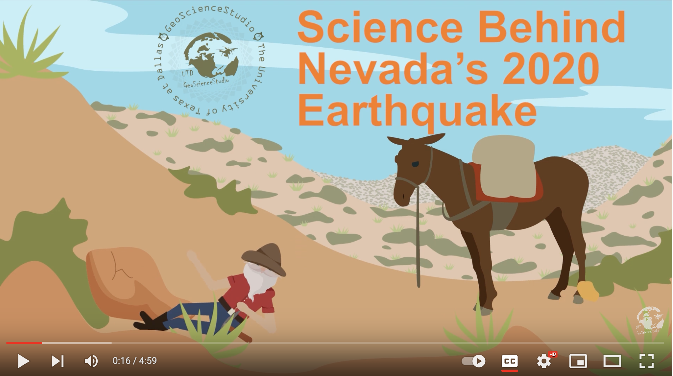
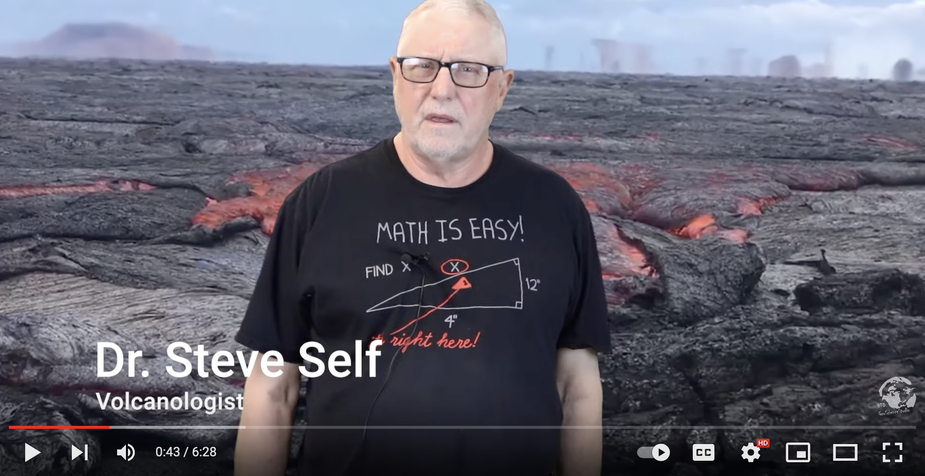
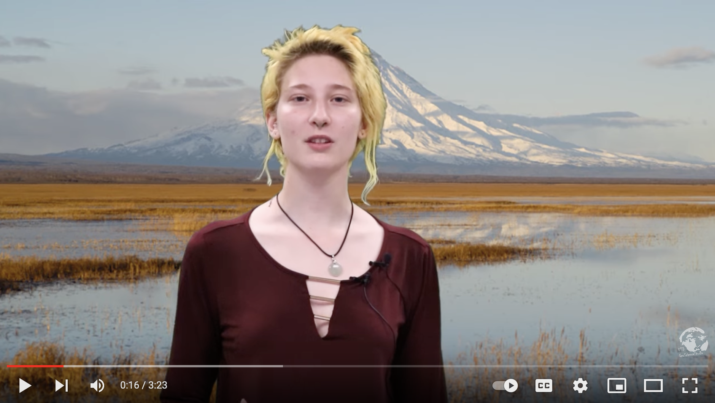
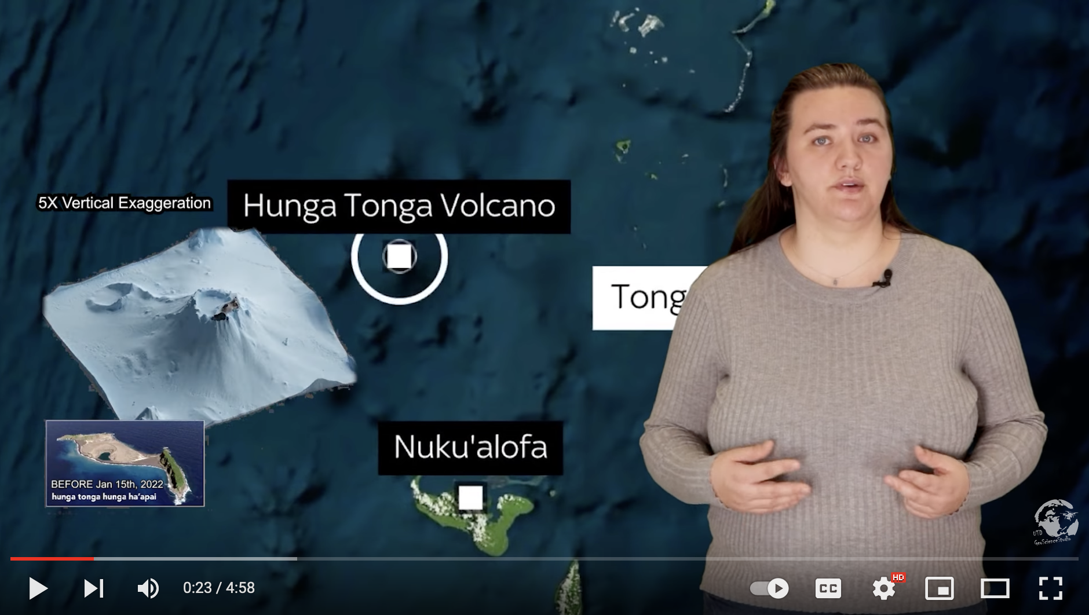
How did the Nevada's 2020 Earthquake happen? (4.4K views)
The Longest Lava Flow on Earth (Aug. 21, 1.3K views)
The Kamchatka Volcanoes (Sept. 21, 0.9K views)
Science Behind Hunga Tonga Volcano Eruption Jan. 22, 4K views)

Slide 4
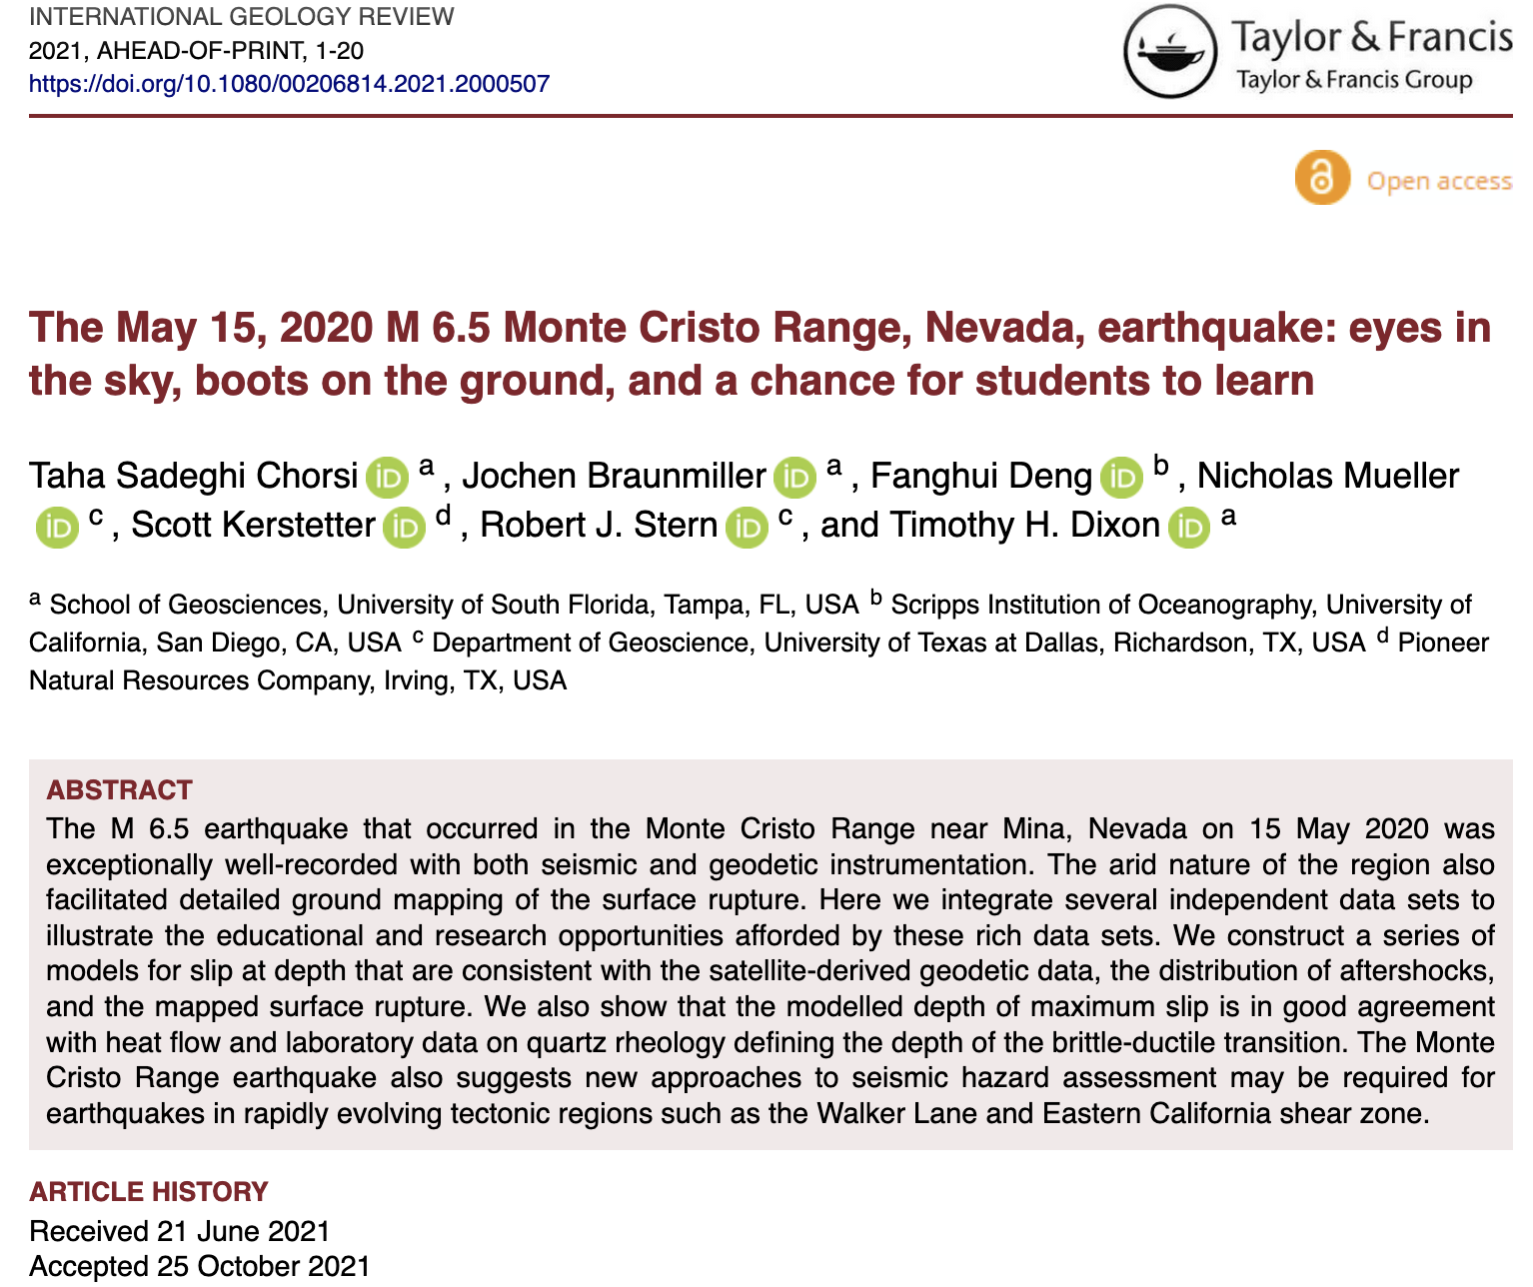
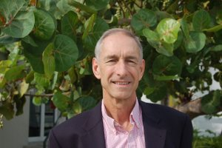
May 2020 event
Writing the narrative required expert input, sparking a conversation with Tim Dixon (U South Florida) about how crustal movements are measured with seismic focal mechanisms, GPS, radar interferometry…
Prof. Tim Dixon, USF
… and led to a paper by 3 USF students and 2 UTD alumni

Slide 5
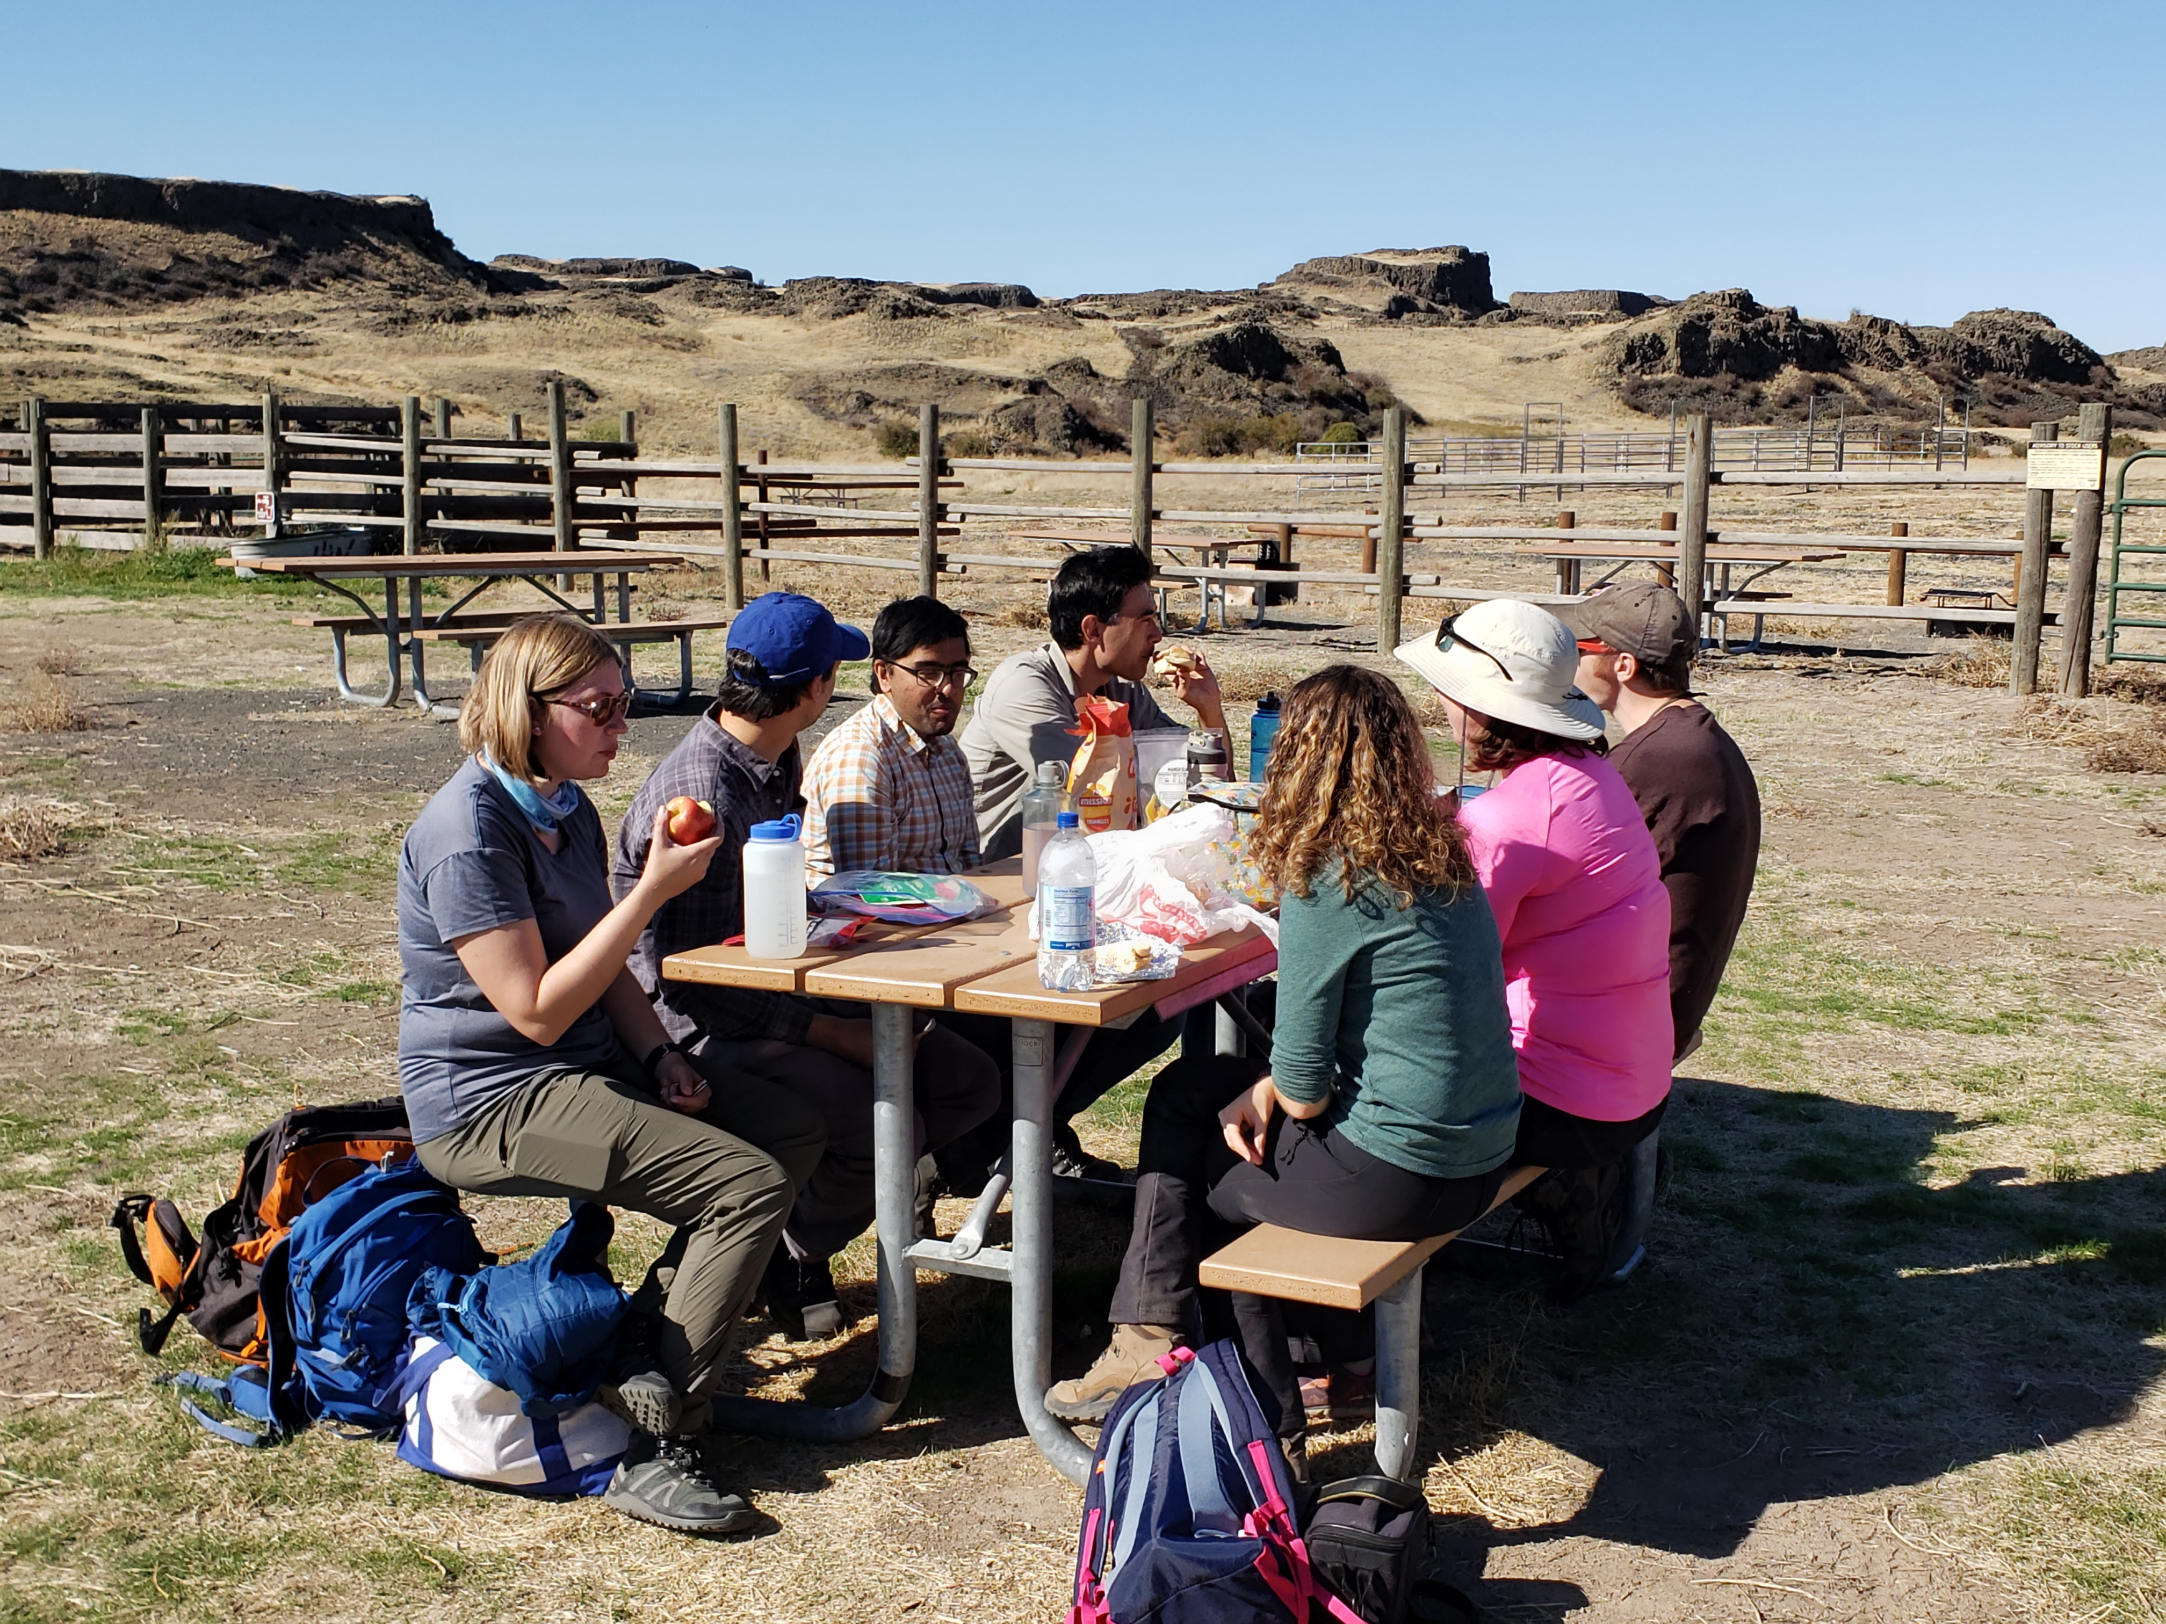
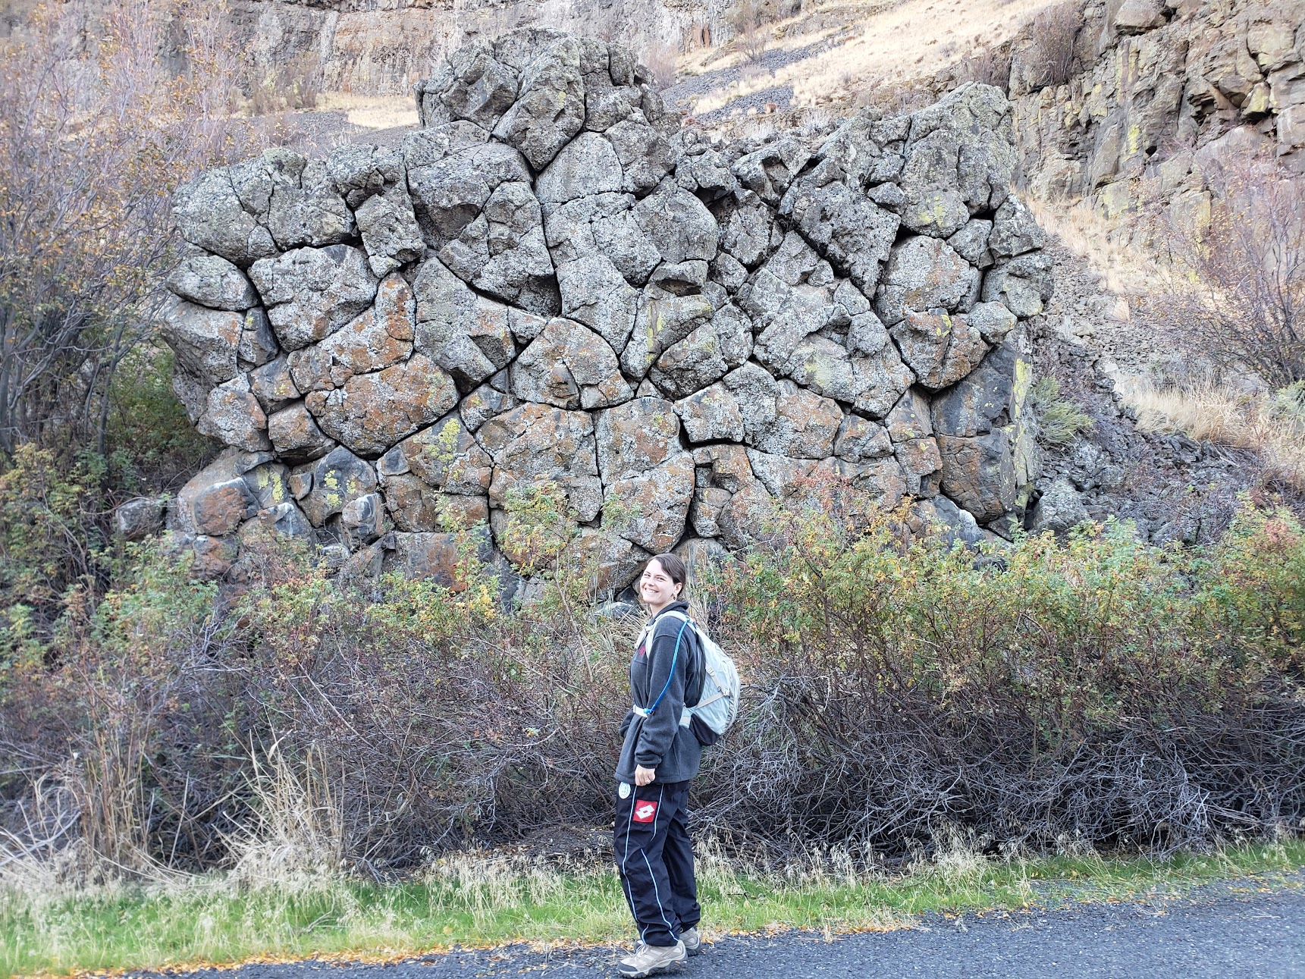
The Longest Lava Flow on Earth (Aug. 21, 1.3K views)
Video about the longest lava flows on Earth required expert input, sparking a conversation with Steven Self (Emeritus Prof UCB) who visited UTD in summer 2021….
….which led to discussions of possible research on the Columbia River Flood Basalts of Washington and involvement of beginning UTD MS student Sarah Walker in a field trip in Oct. 2021 and her MS research topic.

Slide 6
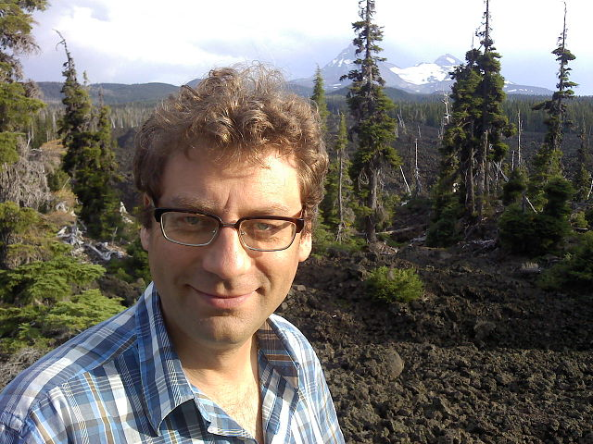
The Kamchatka Volcanoes (Sept. 21)
This video resulted from conversations with UTD undergrad Katie Seals about what she wanted to do when she graduated from UTD. She mentioned an interest in volcanology and I suggested she look at universities with strong volcanology programs, like U Oregon. I further suggested that she find a faculty member whose research interested her…
…she identified Prof. Ilya Bindeman….
…and I suggested that she ask him if he would be interested in working with her to make a video about some of his work. This would give her a chance to dig deeper into a potential supervisor’s research and give him a chance to learn more about a potential student.

Slide 7
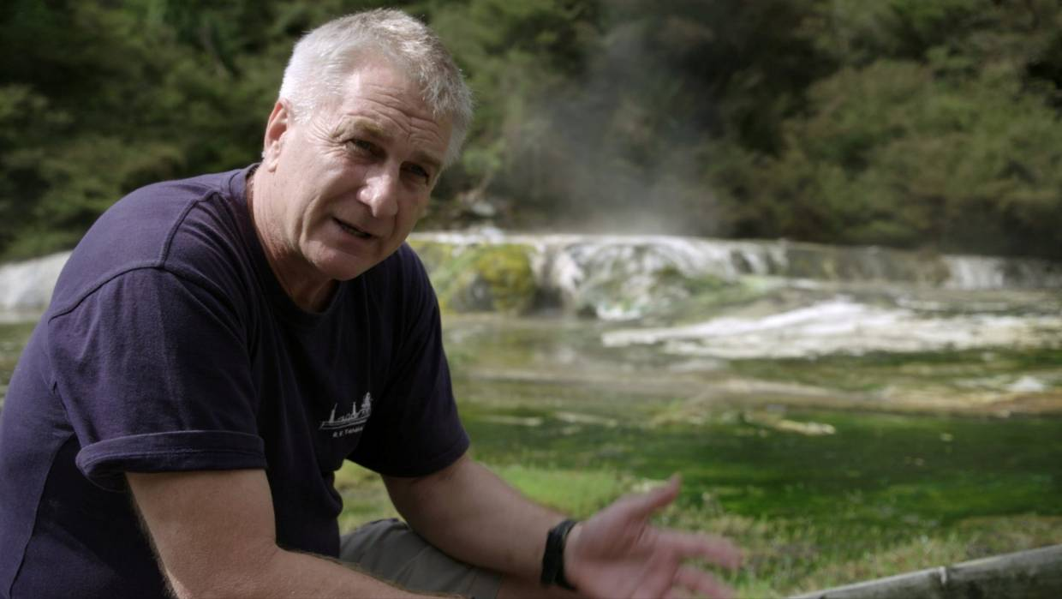
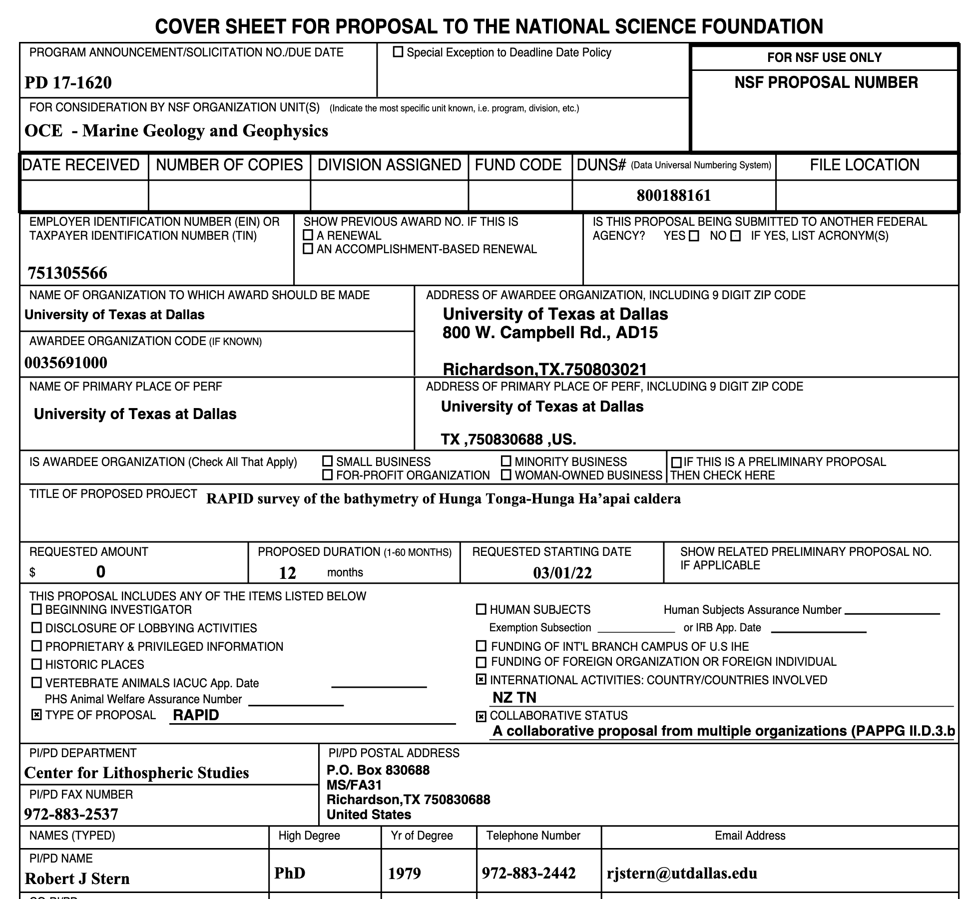
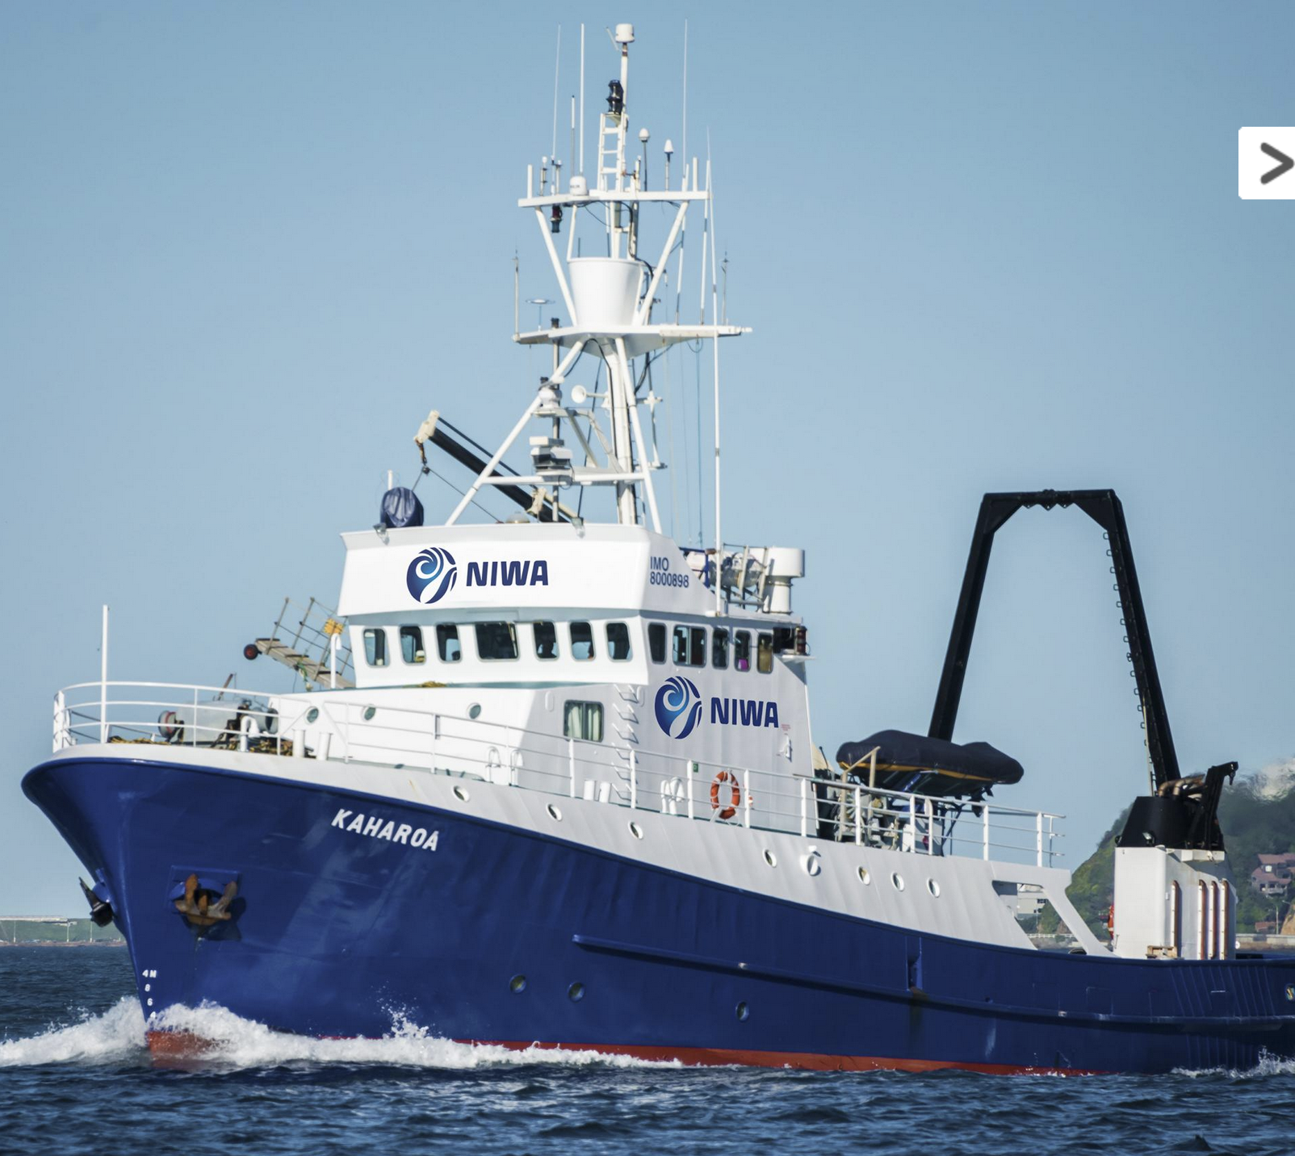
Science Behind Hunga Tonga Volcano Eruption Jan. 22
Writing the narrative for this event required input from experts, so I reached out to Cornel de Ronde, principal scientist at GNS New Zealand…
…He wanted to take a small ship to remap the submarine bathymetry of the volcano with a small ship but needed financial help….
…so we wrote a proposal to NSF to get ~$150K to help with costs and a small amount to support a short Geonews video about the expedition! The proposal will be submitted soon.

